Slide 1
Operating Systems
Memory Management
Fall-2025

Slide 2
Memory Management
Subdividing memory to accommodate multiple processes
Memory needs to be allocated efficiently to pack as many processes into memory as possible

Slide 3
Memory Management Requirements
Relocation
  Programmer does not know where the program will be placed in memory when it is executed
  While the program is executing, it may be swapped to disk and returned to main memory at a different location (relocated)
  Memory references must be translated in the code to actual physical memory address

Slide 4
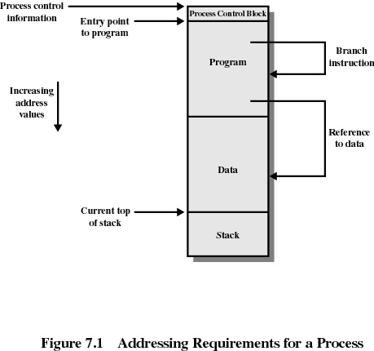

Slide 5
Memory Management Requirements
Protection
  Processes should not be able to reference memory locations in another process without permission
  Impossible to check absolute addresses in programs since the program could be relocated
  Must be checked during execution
    Operating system cannot anticipate all of the memory references a program will make

Slide 6
Memory Management Requirements
Sharing
  Allow several processes to access the same portion of memory
  Better to allow each process (person) access to the same copy of the program rather than have their own separate copy

Slide 7
Memory Management Requirements
Logical Organization
  Programs are written in modules
  Modules can be written and compiled independently
  Different degrees of protection given to modules (read-only, execute-only)
  Share modules

Slide 8
Memory Management Requirements
Physical Organization
  Memory available for a program plus its data may be insufficient
    Overlaying allows various modules to be assigned the same region of memory
  Programmer does not know how much space will be available

Slide 9
Fixed Partitioning
Equal-size partitions
  any process whose size is less than or equal to the partition size can be loaded into an available partition
  if all partitions are full, the operating system can swap a process out of a partition
  a program may not fit in a partition. The programmer must design the program with Overlays

Slide 10
Overlays
Break the big program into small pieces (called overlay segments), each ≤ partition size.
Only one piece (the currently needed part) stays in memory at a time.
When the program needs the next piece, the old piece is overwritten (replaced) in the same partition by the new piece from disk.

Slide 11
Overlays
Overlays = manual swapping of the program parts to fit a large program into small fixed partitions.
Used in very old systems when RAM was tiny.
Modern OS uses Paging instead!

Slide 12
Overlays
The programmer decides which parts of the program are overlays.
The programmer writes extra code (called the overlay manager) that explicitly loads the next overlay from disk and overwrites the old one when needed.
The OS only provides the fixed partition and basic read/write from disk — it has no idea about overlays.

Slide 13
Example-1: Overlay Manager Code
main() {
load_overlay("part1.ovl"); // programmer calls this
part1_function();
load_overlay("part2.ovl"); // programmer calls this again
part2_function();
}

Slide 14
Example-2: Overlay Manager Code
MAIN PROGRAM
// Overlay region in memory (fixed-size partition)
OVERLAY_REGION = allocate_memory(size = 64 KB)
// Load Overlay 1
load_into_overlay("overlay1.bin", OVERLAY_REGION)
call Overlay1_Main()
// Replace Overlay 1 with Overlay 2 in the same memory region
load_into_overlay("overlay2.bin", OVERLAY_REGION)
call Overlay2_Main()
// Replace Overlay 2 with Overlay 3
load_into_overlay("overlay3.bin", OVERLAY_REGION)
call Overlay3_Main()
END PROGRAM

Slide 15
Fixed Partitioning
Main memory use is inefficient. Any program, no matter how small, occupies an entire partition. This is called internal fragmentation.

Slide 16
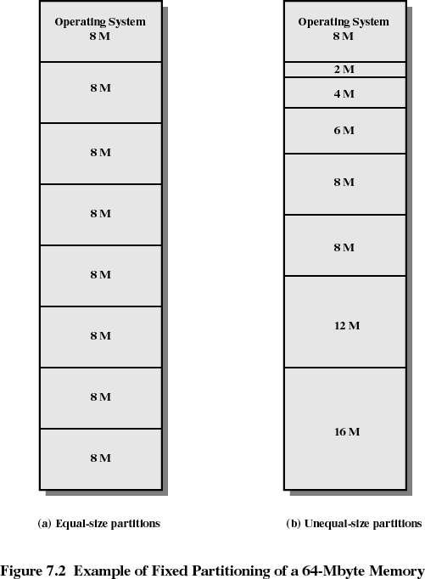

Slide 17
Placement Algorithm with Partitions
Equal-size partitions
  because all partitions are of equal size, it does not matter which partition is used
Unequal-size partitions
  can assign each process to the smallest partition within which it will fit
  queue for each partition
  processes are assigned in such a way as to minimize wasted memory within a partition

Slide 18
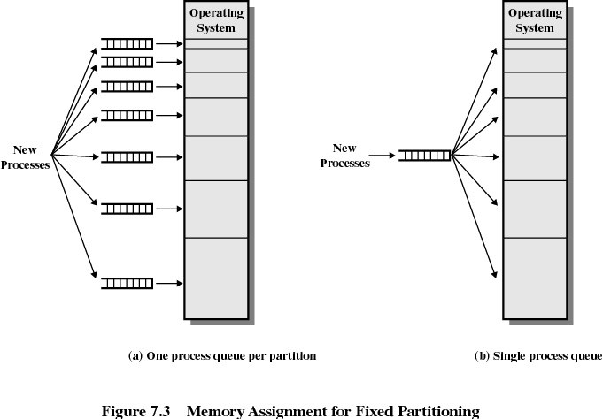

Slide 19
Dynamic Partitioning
Partitions are of variable length and number
Process is allocated exactly as much memory as required
Eventually get holes in the memory. This is called external fragmentation
Must use compaction to shift processes so they are contiguous and all free memory is in one block

Slide 20
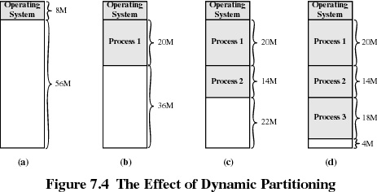

Slide 21
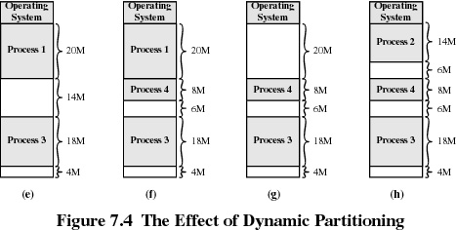

Slide 22
Dynamic Partitioning Placement Algorithms
The operating system must decide which free block to allocate to a process
For this some kind of criteria or policy must be implemented so as to accommodate the incoming processes and manage external fragmentation as well.
Following policies are implemented in placement decisions

Slide 23
Dynamic Partitioning Placement Algorithms
Best-fit algorithm
  Free storage list is kept in Ascending order
  Chooses the block that is closest in size to the incoming process request
  Worst performer overall
  Since smallest block is found for process, the smallest amount of fragmentation is left
  Thus, memory compaction must be done more often resulting in more overhead

Slide 24
Dynamic Partitioning Placement Algorithm
First-fit algorithm
  Free storage list is kept in address order or sometimes in random order
  Fastest
  An incoming process is placed in the memory in the first available hole large enough to hold it.
  It has also intuitive appeal in that it allows the placement decision to be made quickly.

Slide 25
Dynamic Partitioning Placement Algorithm
Next-fit
A variation of First Fit
It begins each search for an available hole at the point where the previous search ended.

Slide 26
Dynamic Partitioning Placement Algorithm
Worst-fit
Free storage list is kept in Descending order
Although it seems to be a illogical policy, yet it gives the best result in terms of fragmentation!
It places a process in the memory in the hole in which it fits worst, i.e., the largest possible hole.
After placing the process in the largest hole, the remaining hole is also large and is thus able to hold a relatively large new process.

Slide 27
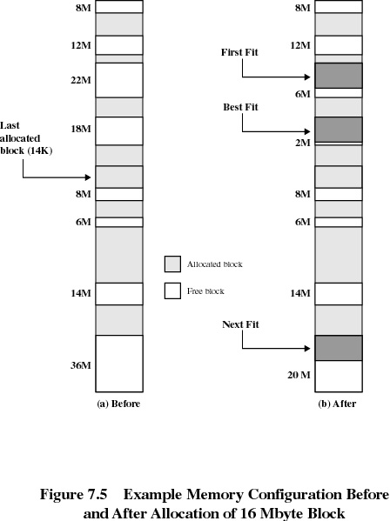

Slide 28
Buddy System
Entire space available is treated as a single block of 2^{U}
If a request of size s such that
2^{U-1} < s <= 2^{U}, entire block is allocated
  Otherwise block is split into two equal buddies
  Process continues until smallest block greater than or equal to s is generated

Slide 29
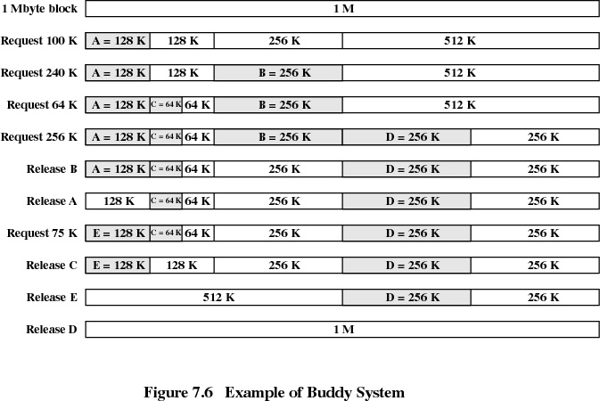

Slide 30
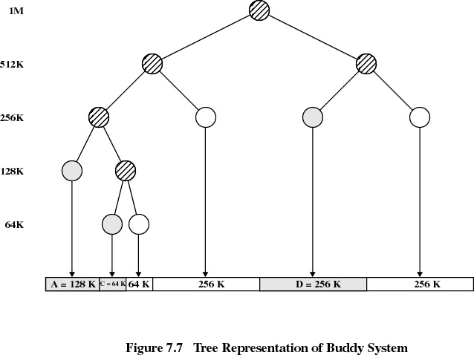

Slide 31
Relocation
When program loaded into memory the actual (absolute) memory locations are determined
A process may occupy different partitions which means different absolute memory locations during execution (from swapping)
Compaction will also cause a program to occupy a different partition which means different absolute memory locations

Slide 32
Addresses
Logical
  reference to a memory location independent of the current assignment of data to memory
  translation must be made to the physical address
Relative
  address expressed as a location relative to some known point
Physical
  the absolute address or actual location in main memory

Slide 34
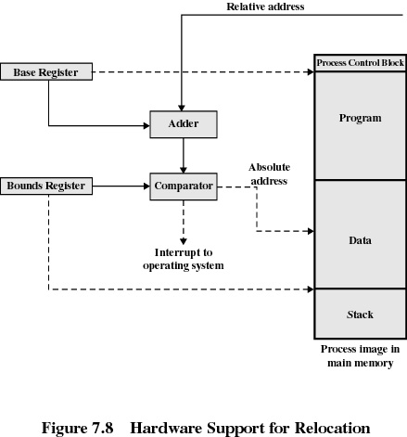

Slide 35
Registers Used during Execution
Base register
  starting address for the process
Bounds register
  ending location of the process
These values are set when
  the process is loaded, and
  when the process is swapped in

Slide 36
Registers Used during Execution
The value of the base register is added to a relative address to produce an absolute address
The resulting address is compared with the value in the bounds register
If the address is not within bounds, an interrupt is generated to the operating system

Slide 37
Paging
Partition memory into small equal-size chunks and divide each process into the same size chunks
The chunks of a process are called pages and chunks of memory are called frames
Operating system maintains a Page Table for each process
  contains the frame location for each page in the process
  memory address consist of a page number and offset within the page

Slide 38
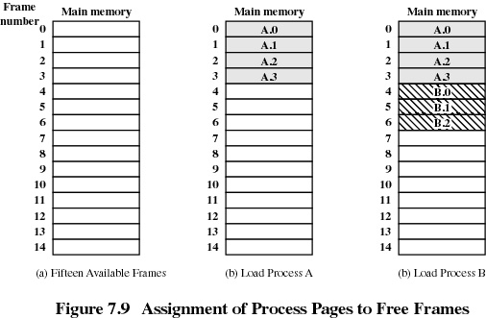

Slide 39
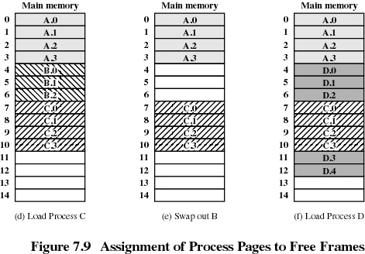

Slide 40
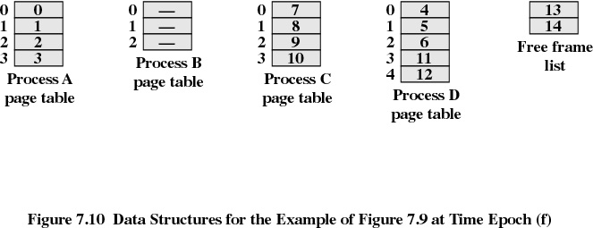
Page Tables for Example

Slide 41
Address Translation Scheme
Address generated by CPU is divided into:
  Page number (p) – used as an index into a page table which contains base address of each page in physical memory.
  Page offset (d) – combined with base address to define the physical memory address that is sent to the memory unit.
Operating System Concepts

Slide 42


Address Translation Architecture
Operating System Concepts

Slide 43

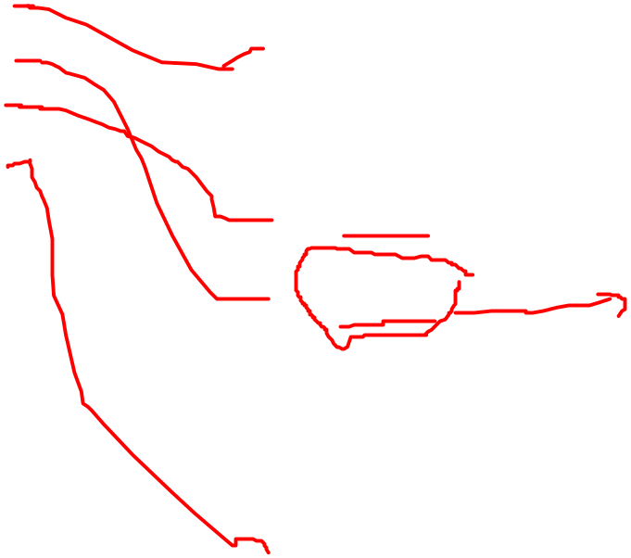
Paging Example
Operating System Concepts

Slide 44

Paging Example
Operating System Concepts

Slide 45

Free Frames
Operating System Concepts
Before allocation
After allocation

Slide 46

Valid (v) or Invalid (i) Bit In A Page Table
Operating System Concepts

Slide 47
Implementation of Page Table
Page table is kept in main memory.
Page-table base register (PTBR) points to the page table.
Page-table length register (PTLR) indicates size of the page table.
In this scheme every data/instruction access requires two memory accesses. One for the page table and one for the data/instruction.
The two memory access problem can be solved by the use of a special fast-lookup hardware cache called associative memory or translation look-aside buffers (TLBs)
Operating System Concepts

Slide 48
Associative Memory
Associative memory – parallel search
Address translation (A´, A´´)
  If A´ is in associative register, get frame # out.
  Otherwise get frame # from page table in memory
Page #
Frame #
Operating System Concepts

Slide 49

Paging Hardware With TLB
Operating System Concepts

Slide 50
Demand Paging
Demand paging: allows pages that are referenced actively to be loaded into memory
  Remaining pages stay on disk
  Provides the illusion of infinite physical memory

Slide 51
Demand Paging Mechanism
Page tables sometimes need to point to disk locations (as opposed to memory locations)
A table entry needs a present (valid) bit
  Present (1) means a page is in memory
  Not present (0) means that there is a page fault

Slide 52
Page Fault
Hardware trap
OS performs the following steps while running other processes (analogy: firing and hiring someone)
  Choose a page
  If the page has been modified, write its contents to disk
  Change the corresponding page table entry and TLB entry
  Load new page into memory from disk
  Update page table entry
  Continue the thread

Slide 53
Segmentation
Memory-management scheme that supports user view of memory.
A program is a collection of segments. A segment is a logical unit such as:
main program,
procedure,
function,
method,
object,
local variables, global variables,
common block,
stack,
symbol table, arrays
Operating System Concepts

Slide 54

User’s View of a Program
Operating System Concepts

Slide 55
Logical View of Segmentation
1
1
4
2
3
2
4
3
user space
physical memory space
Operating System Concepts

Slide 56
Segmentation Architecture
Logical address consists of a two tuple:
<segment-number, offset>,
Segment table – maps two-dimensional physical addresses; each table entry has:
  base – contains the starting physical address where the segments reside in memory.
  limit – specifies the length of the segment.
Segment-table base register (STBR) points to the segment table’s location in memory.
Segment-table length register (STLR) indicates number of segments used by a program;
segment number s is legal if s < STLR.
Operating System Concepts

Slide 57
Segmentation Architecture (Cont.)
Relocation.
  dynamic
  by segment table
Sharing.
  shared segments
  same segment number
Allocation.
  first fit/best fit
  external fragmentation
Operating System Concepts

Slide 58
Segmentation Architecture (Cont.)
Protection. With each entry in segment table associate:
  validation bit = 0 ⇒ illegal segment
  read/write/execute privileges
Protection bits associated with segments; code sharing occurs at segment level.
Since segments vary in length, memory allocation is a dynamic storage-allocation problem.
A segmentation example is shown in the following diagram
Operating System Concepts

Slide 59

Segmentation Hardware
Operating System Concepts

Slide 60

Example of Segmentation
Operating System Concepts

Slide 61

Sharing of Segments
Operating System Concepts

Slide 62
Page Replacement Algorithms
These policies are concerned with deciding which page or segment to displace/remove to make room for an incoming page (or segment) when the main memory is already full.
Following are these strategies:

Slide 63
1. The Principle of Optimality
In this strategy, that page is replaced that will not be used again for the furthest time into the future.
Although it is possible to demonstrate the optimality of this strategy, it cannot be fully applied since the future cannot be predicted.

Slide 64
2. Random Page Replacement
It’s a simple technique in which all pages in the main storage have an equal probability of being selected for replacement.
This strategy could select any page for replacement, including the next page to be referenced (which is, of course the worst page to replace).
Since it’s a hit-or-miss approach, this scheme is rarely used.

Slide 65
3. FIFO (First-In-First-Out) Page Replacement
Each page is time-stamped as it enters (arrives) the main memory.
The page which has stayed longest in the main memory is chosen to be replaced (since it had arrived first).
The general technique of this strategy is that, since this page has had its chance and it’s time to give another page a chance.
Negative: Under this scheme a heavily used page is likely to be replaced, because it has been in the memory for a long time (remember the time-stamp!). And it’s the same page that has been in constant use and is likely to be used again in the future.

Slide 66
Implementation: This strategy can also be implemented with a simple FIFO queue.
As each page arrives, it is placed at the tail of the queue and pages are replaced from the head of the queue.
-ve: The overhead of keeping the
time-stamp.
Belady’s Anomaly (Reading Homework Assignment).

Slide 67

Example
A process makes references to 4 pages: A, B, E, and R
  Reference stream: BEERBAREBEAR
Physical memory size: 3 pages

Slide 68
FIFO
Memory page | B | E | E | R | B | A | R | E | B | E | A | R
1 | B
2
3

Slide 69
FIFO
Memory page | B | E | E | R | B | A | R | E | B | E | A | R
1 | B
2 |  | E
3

Slide 70
FIFO
Memory page | B | E | E | R | B | A | R | E | B | E | A | R
1 | B
2 |  | E | *
3

Slide 71
FIFO
Memory page | B | E | E | R | B | A | R | E | B | E | A | R
1 | B
2 |  | E | *
3 |  |  |  | R

Slide 72
FIFO
Memory page | B | E | E | R | B | A | R | E | B | E | A | R
1 | B |  |  |  | *
2 |  | E | *
3 |  |  |  | R

Slide 73
FIFO
Memory page | B | E | E | R | B | A | R | E | B | E | A | R
1 | B |  |  |  | *
2 |  | E | *
3 |  |  |  | R

Slide 74
FIFO
Memory page | B | E | E | R | B | A | R | E | B | E | A | R
1 | B |  |  |  | * | A
2 |  | E | *
3 |  |  |  | R

Slide 75
FIFO
Memory page | B | E | E | R | B | A | R | E | B | E | A | R
1 | B |  |  |  | * | A
2 |  | E | *
3 |  |  |  | R |  |  | *

Slide 76
FIFO
Memory page | B | E | E | R | B | A | R | E | B | E | A | R
1 | B |  |  |  | * | A
2 |  | E | * |  |  |  |  | *
3 |  |  |  | R |  |  | *

Slide 77
FIFO
Memory page | B | E | E | R | B | A | R | E | B | E | A | R
1 | B |  |  |  | * | A
2 |  | E | * |  |  |  |  | *
3 |  |  |  | R |  |  | *

Slide 78
FIFO
Memory page | B | E | E | R | B | A | R | E | B | E | A | R
1 | B |  |  |  | * | A
2 |  | E | * |  |  |  |  | * | B
3 |  |  |  | R |  |  | *

Slide 79
FIFO
Memory page | B | E | E | R | B | A | R | E | B | E | A | R
1 | B |  |  |  | * | A
2 |  | E | * |  |  |  |  | * | B
3 |  |  |  | R |  |  | *

Slide 80
FIFO
Memory page | B | E | E | R | B | A | R | E | B | E | A | R
1 | B |  |  |  | * | A
2 |  | E | * |  |  |  |  | * | B
3 |  |  |  | R |  |  | * |  |  | E

Slide 81
FIFO
Memory page | B | E | E | R | B | A | R | E | B | E | A | R
1 | B |  |  |  | * | A |  |  |  |  | *
2 |  | E | * |  |  |  |  | * | B
3 |  |  |  | R |  |  | * |  |  | E

Slide 82
FIFO
Memory page | B | E | E | R | B | A | R | E | B | E | A | R
1 | B |  |  |  | * | A |  |  |  |  | *
2 |  | E | * |  |  |  |  | * | B
3 |  |  |  | R |  |  | * |  |  | E

Slide 83
FIFO
Memory page | B | E | E | R | B | A | R | E | B | E | A | R
1 | B |  |  |  | * | A |  |  |  |  | * | R
2 |  | E | * |  |  |  |  | * | B
3 |  |  |  | R |  |  | * |  |  | E

Slide 84
FIFO
7 page faults
Memory page | B | E | E | R | B | A | R | E | B | E | A | R
1 | B |  |  |  | * | A |  |  |  |  | * | R
2 |  | E | * |  |  |  |  | * | B
3 |  |  |  | R |  |  | * |  |  | E

Slide 85
4. LRU (Least-Recently-Used)
This strategy selects that page for replacement that has not been used for the longest time.
The principle here is that “the recent past is a good indicator of the near future”.
LRU requires that each page be time-stamped whenever it is referenced.
-ve: This strategy requires substantial overhead, and thus although it’s appealing, it is not often implemented in current systems. However, lower overhead strategies that approximate LRU are used.

Slide 86
Implementation: This strategy can be implemented with a list structure containing one entry for each occupied page frame.
  Each time a page frame is referenced, the entry for that page is placed at the head of the list.
  Older entries migrate toward the tail of the list.
When a page must be replaced to make room for an incoming page, the entry at the tail of the list is selected, the corresponding page is freed, and the incoming page is placed at the head of the list because that page is now the one that has been most recently used.

Slide 87
LRU
Memory page | B | E | E | R | B | A | R | E | B | E | A | R
1 | B
2 |  | E | *
3 |  |  |  | R

Slide 88
LRU
Memory page | B | E | E | R | B | A | R | E | B | E | A | R
1 | B |  |  |  | *
2 |  | E | *
3 |  |  |  | R

Slide 89
LRU
Memory page | B | E | E | R | B | A | R | E | B | E | A | R
1 | B |  |  |  | *
2 |  | E | *
3 |  |  |  | R

Slide 90
LRU
Memory page | B | E | E | R | B | A | R | E | B | E | A | R
1 | B |  |  |  | *
2 |  | E | * |  |  | A
3 |  |  |  | R

Slide 91
LRU
Memory page | B | E | E | R | B | A | R | E | B | E | A | R
1 | B |  |  |  | *
2 |  | E | * |  |  | A
3 |  |  |  | R |  |  | *

Slide 92
LRU
Memory page | B | E | E | R | B | A | R | E | B | E | A | R
1 | B |  |  |  | *
2 |  | E | * |  |  | A
3 |  |  |  | R |  |  | *

Slide 93
LRU
Memory page | B | E | E | R | B | A | R | E | B | E | A | R
1 | B |  |  |  | * |  |  | E
2 |  | E | * |  |  | A
3 |  |  |  | R |  |  | *

Slide 94
LRU
Memory page | B | E | E | R | B | A | R | E | B | E | A | R
1 | B |  |  |  | * |  |  | E
2 |  | E | * |  |  | A
3 |  |  |  | R |  |  | *

Slide 95
LRU
Memory page | B | E | E | R | B | A | R | E | B | E | A | R
1 | B |  |  |  | * |  |  | E
2 |  | E | * |  |  | A |  |  | B
3 |  |  |  | R |  |  | *

Slide 96
LRU
Memory page | B | E | E | R | B | A | R | E | B | E | A | R
1 | B |  |  |  | * |  |  | E |  | *
2 |  | E | * |  |  | A |  |  | B
3 |  |  |  | R |  |  | *

Slide 97
LRU
Memory page | B | E | E | R | B | A | R | E | B | E | A | R
1 | B |  |  |  | * |  |  | E |  | *
2 |  | E | * |  |  | A |  |  | B
3 |  |  |  | R |  |  | *

Slide 98
LRU
Memory page | B | E | E | R | B | A | R | E | B | E | A | R
1 | B |  |  |  | * |  |  | E |  | *
2 |  | E | * |  |  | A |  |  | B
3 |  |  |  | R |  |  | * |  |  |  | A

Slide 99
LRU
Memory page | B | E | E | R | B | A | R | E | B | E | A | R
1 | B |  |  |  | * |  |  | E |  | *
2 |  | E | * |  |  | A |  |  | B
3 |  |  |  | R |  |  | * |  |  |  | A

Slide 100
LRU
Memory page | B | E | E | R | B | A | R | E | B | E | A | R
1 | B |  |  |  | * |  |  | E |  | *
2 |  | E | * |  |  | A |  |  | B |  |  | R
3 |  |  |  | R |  |  | * |  |  |  | A

Slide 101
LRU
8 page faults
Memory page | B | E | E | R | B | A | R | E | B | E | A | R
1 | B |  |  |  | * |  |  | E |  | *
2 |  | E | * |  |  | A |  |  | B |  |  | R
3 |  |  |  | R |  |  | * |  |  |  | A

Slide 102
5. LFU (Least-Frequently-Used)
The thing to be considered here is “how intensive the use of each page has been”.
The page to replace is that page that is least frequently used or least intensively referenced.
-ve: The wrong page could quite easily be selected for replacement, e.g., the least frequently used page could be the page brought into main memory most recently. This page has been used once whereas all other pages in the main storage could have been used more than once. So, this technique replaces this page when in fact it would be highly likely to be used immediately.

Slide 103
LFU
Memory page | B | E | E | R | B | A | R | E | B | E | A | R
1 | B
2
3

Slide 104
LFU
Memory page | B | E | E | R | B | A | R | E | B | E | A | R
1 | B
2 |  | E
3

Slide 105
LFU
Memory page | B | E | E | R | B | A | R | E | B | E | A | R
1 | B
2 |  | E | 2
3

Slide 106
LFU
Memory page | B | E | E | R | B | A | R | E | B | E | A | R
1 | B
2 |  | E | 2
3 |  |  |  | R

Slide 107
LFU
Memory page | B | E | E | R | B | A | R | E | B | E | A | R
1 | B |  |  |  | 2
2 |  | E | 2
3 |  |  |  | R

Slide 108
LFU
Memory page | B | E | E | R | B | A | R | E | B | E | A | R
1 | B |  |  |  | 2
2 |  | E | 2
3 |  |  |  | R |  | A

Slide 109
LFU
Memory page | B | E | E | R | B | A | R | E | B | E | A | R
1 | B |  |  |  | 2
2 |  | E | 2
3 |  |  |  | R |  | A | R

Slide 110
LFU
Memory page | B | E | E | R | B | A | R | E | B | E | A | R
1 | B |  |  |  | 2
2 |  | E | 2 |  |  |  |  | 3
3 |  |  |  | R |  | A | R

Slide 111
LFU
Memory page | B | E | E | R | B | A | R | E | B | E | A | R
1 | B |  |  |  | 2 |  |  |  | 3
2 |  | E | 2 |  |  |  |  | 3
3 |  |  |  | R |  | A | R

Slide 112
LFU
Memory page | B | E | E | R | B | A | R | E | B | E | A | R
1 | B |  |  |  | 2 |  |  |  | 3
2 |  | E | 2 |  |  |  |  | 3 |  | 4
3 |  |  |  | R |  | A | R

Slide 113
LFU
Memory page | B | E | E | R | B | A | R | E | B | E | A | R
1 | B |  |  |  | 2 |  |  |  | 3
2 |  | E | 2 |  |  |  |  | 3 |  | 4
3 |  |  |  | R |  | A | R |  |  |  | A

Slide 114
LFU
Memory page | B | E | E | R | B | A | R | E | B | E | A | R
1 | B |  |  |  | 2 |  |  |  | 3
2 |  | E | 2 |  |  |  |  | 3 |  | 4
3 |  |  |  | R |  | A | R |  |  |  | A | R

Slide 115
LFU
7 page faults
Memory page | B | E | E | R | B | A | R | E | B | E | A | R
1 | B |  |  |  | 2 |  |  |  | 3
2 |  | E | 2 |  |  |  |  | 3 |  | 4
3 |  |  |  | R |  | A | R |  |  |  | A | R

Slide 116
6. NUR (Not-Used-Recently)
Pages not used recently are not likely to be used in the near future and they may be replaced with incoming pages.
This is a scheme for approximating LRU with little overhead.
Implementation: NUR is implemented with addition of two hardware bits per page.
These are:
(1). Reference bit = 0 if the page has not been referenced
1 if the page has been referenced
(2). Dirty bit = 0 if the page has not been modified
1 if the page has been modified

Slide 117
Initially, the reference bits of all pages are set to 0.
If a particular page is referenced, its reference bit is set to 1.
Initially, the dirty bits of all pages are also set to 0.
Whenever a page is modified, its modified bit is set to 1.
When a page is to be replaced, the OS first tries to find a page which has not been referenced (otherwise, we have no choice but to replace a referenced page).
If a page has not been referenced, we check whether it has been modified or not.
If it has not been modified, we replace it on the basis that there is less overhead involved than in replacing a modified page that must be written back to secondary storage.
Otherwise, a modified page is replaced.

Slide 118
The Principle of Locality
The Principle of Locality states that “processes tend to reference storage in non-uniform, highly localized patterns”.
Locality is of two types as follows:
  Temporal Locality
  Spatial Locality

Slide 119
Temporal Locality
Temporal Locality relates to Time.
Example: Weather w.r.t. time.
It means that storage locations referenced recently are likely to be referenced in the near future.
Supporting this observation are stacks, subroutines, looping and variables used for counting and totaling.

Slide 120
Spatial Locality
Spatial Locality relates to Space.
Example: Weather w.r.t. space.
It means that storage references tend to be clustered so that once a location is referenced; it is highly likely that nearby locations will be referenced. Supporting this observation are array traversals, sequential code execution and the tendency of programmers to place related variable definitions near one another.

Slide 121
Working Set Theory
Denning formulated the working set theory of program behavior based upon observations of locality.
A working set is a collection of pages a process is actively referencing.
The real working set of a process is the set of pages that must be in main memory for a process to execute efficiently.
Denning maintained that for a program to run efficiently, its working set of pages must be maintained in the main memory.
Else, excessive paging activity (Thrashing) might occur as the program repeatedly requests pages from the secondary storage.

